Slide 1




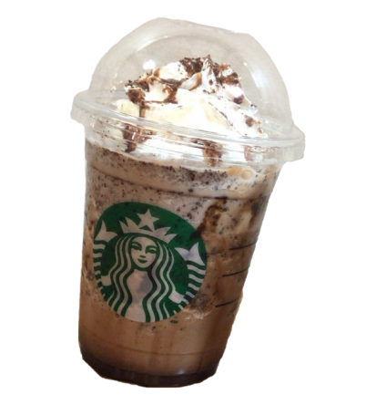
MENU
REWARDS
GIFT CARD
SATRBUCKS
Select a heading below to open it and see a list of links to PowerPoint Help.
Select a heading below to open it and see a list of links to PowerPoint Help.
Select a heading below to open it and see a list of links to PowerPoint Help.
Frappuccho*
Blended believe

Slide 2

SATRBUCKS
Select a heading below to open it and see a list of links to PowerPoint Help.
Select a heading below to open it and see a list of links to PowerPoint Help.
Select a heading below to open it and see a list of links to PowerPoint Help.

Slide 3
SATRBUCKS
Select a heading below to open it and see a list of links to PowerPoint Help.
Select a heading below to open it and see a list of links to PowerPoint Help.
Select a heading below to open it and see a list of links to PowerPoint Help.

Slide 4
SATRBUCKS
Select a heading below to open it and see a list of links to PowerPoint Help.
Select a heading below to open it and see a list of links to PowerPoint Help.
Select a heading below to open it and see a list of links to PowerPoint Help.

Slide 5
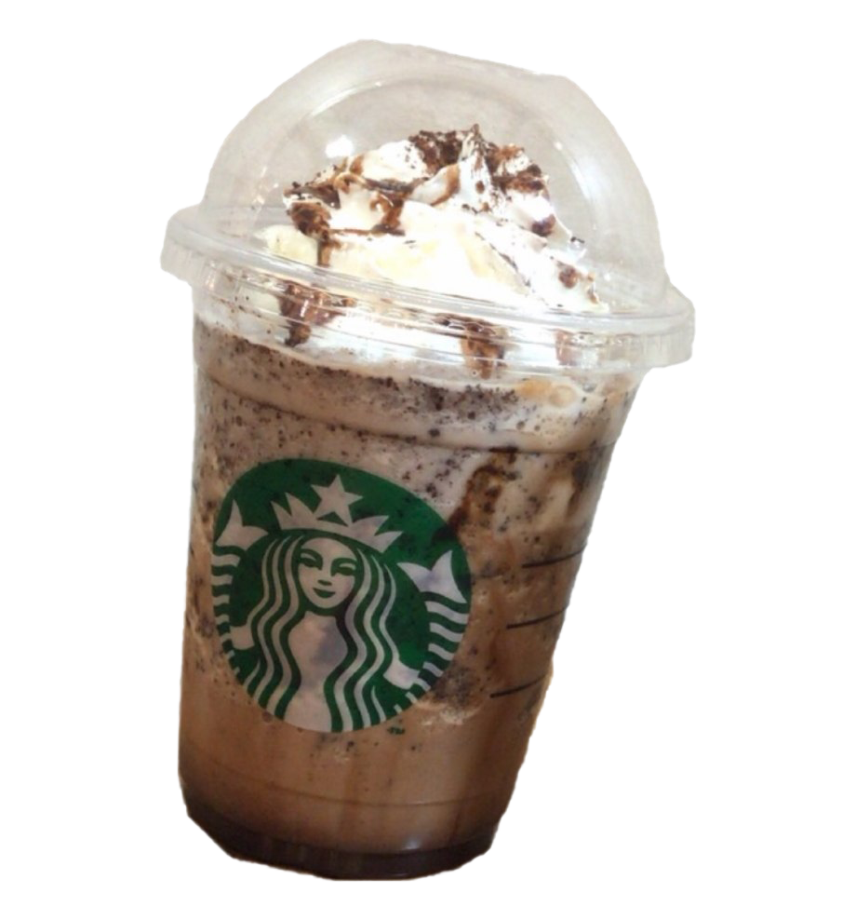
SATRBUCKS
Select a heading below to open it and see a list of links to PowerPoint Help.
Select a heading below to open it and see a list of links to PowerPoint Help.
Select a heading below to open it and see a list of links to PowerPoint Help.

Slide 6
MENU
REWARDS
GIFT CARD
SATRBUCKS
Select a heading below to open it and see a list of links to PowerPoint Help.
Select a heading below to open it and see a list of links to PowerPoint Help.
Select a heading below to open it and see a list of links to PowerPoint Help.
Frappuccho*
Blended believe

